Slide 1
Nerve Cell Structure and Nerve Impulses

Slide 2
Nerve cells
The basic unit of the nervous system.
Made up of three basic components:
Cell body: contains the nucleus, along with the usual cell contents – mitochondria, golgi, endoplasmic reticulum and ribosomes.
Dendrites: carry messages (electrical impulses) into the cell body
Axon: carries nerve impulses away from the cell body

Slide 3
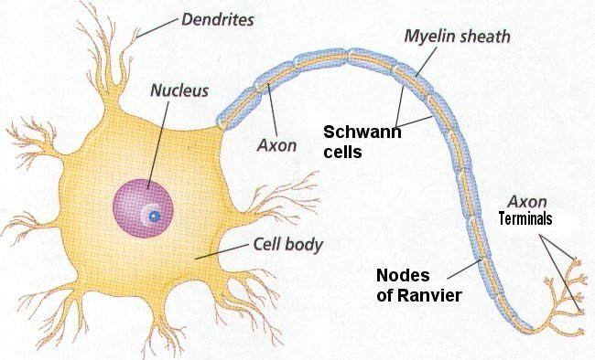
Basic nerve cell structure

Slide 4
Dendrites
Often short and highly branched.
Carry sensory information as electrical impulses, often from a variety of places in the same local area.

Slide 5
Axon
Often longer than dendrites but not always
Sometimes covered in myelin – a fatty substance which provides insulation and causes the electrical impulse to move along the axon faster.
Grey matter – unmyelinated fibres
White matter – myelinated fibres

Slide 6
Types of nerve cells
There are a variety of types of nerve cells which will become more important when we look at the Peripheral Nervous system (PNS).
The CNS is mostly made up of interneurons which contain many branches capable of sending and receiving nerve impulses.

Slide 7
Classifying Neurons By Structure
Multipolar neurons: one axon and multiple dendrites. E.g. interneurons in the brain and motor neurons.
Bipolar neurons: one axon and one dendrite, possibly with many branches at the very end. E.g. eye, ear, nose carrying receptor cell to another neuron.
Unipolar neurons: one axon and no dendrites. The cell body sits to the side. E.g. a neuron carrying sensory information from a receptor to the CNS

Slide 8
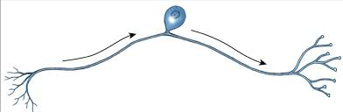
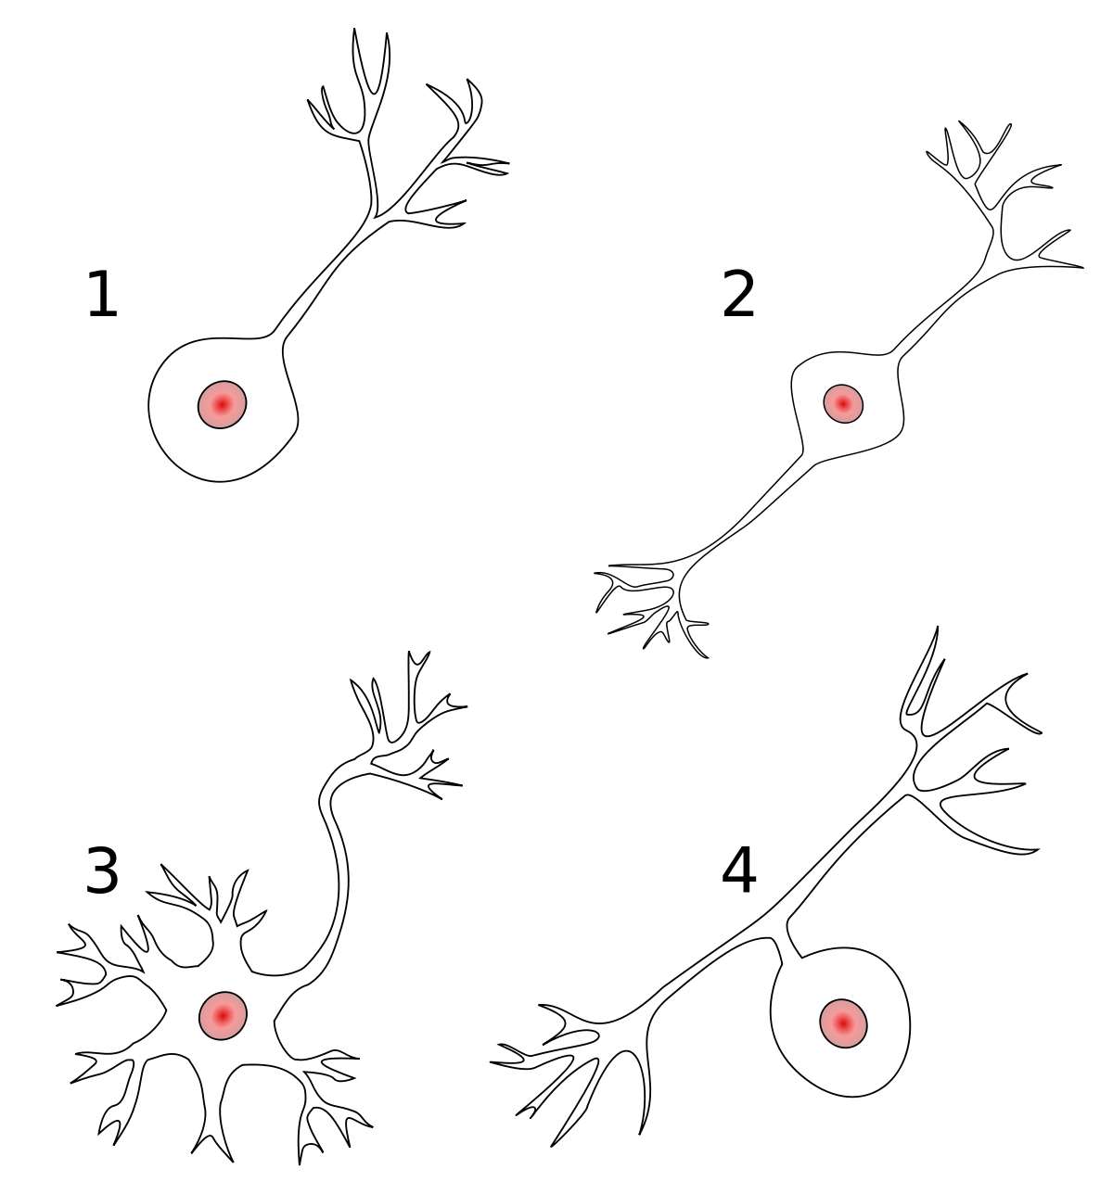
1. Name and describe
1 is a true unipolar. 4 is pseudounipolar

Slide 9
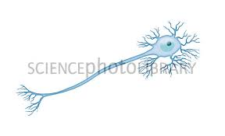
2. Name and Describe

Slide 10
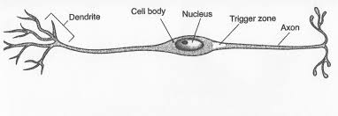
3. Name and Describe

Slide 11
Electrical charges
Positive charges and negative charges can exist.
Like charges repel, opposite charges attract.
The force that pulls a negative charge to a positive charge can be measured – The closer they get, the stronger the force gets.
When a positive and negative charge comes together energy is released.
If a positive and negative charge are separated by a barrier – they have the potential to release energy.

Slide 12
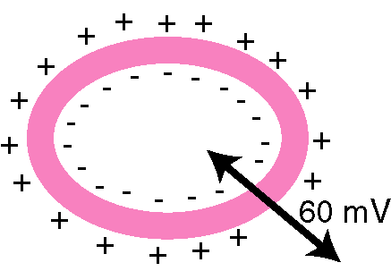
Electrical charges
The potential is measured in volts.
In a nerve cell the membrane forms a barrier. Inside the cell has more negative ions and outside it has more positive ions.
The membrane potential is the difference between the charge inside the cell and the charge outside the cell
Notes:
http://images.google.com.au/imgres?imgurl=http://course1.winona.edu/sberg/ILLUST/membpot4.gif&imgrefurl=http://course1.winona.edu/sberg/308s10/Lec-note/NervesA.htm&usg=__ExXSIZD9nZ0CduRhtua1wKGLYts=&h=303&w=437&sz=3&hl=en&start=1&um=1&itbs=1&tbnid=tQFgJrNuko31xM:&tbnh=87&tbnw=126&prev=/images%3Fq%3Dmembrane%2Bcharges%26um%3D1%26hl%3Den%26safe%3Dstrict%26rlz%3D1T4SKPB_enAU368AU369%26tbs%3Disch:1

Slide 13
Important ions
Extracellular fluid:
Sodium (Na⁺) high [ ]
Chloride (Cl⁻)
Potassium (K⁺) low [ ]
Intracellular fluid
Potassium (K⁺) high [ ]
Sodium (Na⁺) low [ ]
Variety of organic (contain carbon, manufactured by the cell) anions (negative charged ions)
Notes:
http://scienceblogs.com/clock/2006/06/bio101_lecture_6_physiology_re.php

Slide 14
Resting membrane potential
The membrane potential of an unstimulated nerve cell.
-70 mV (meaning the potential of the inside of the cell is 70 mV less than the outside)
This is maintained by the concentration of sodium and potassium ions.
Extracellular fluid is mostly NaCl, the intracellular contains a high concentration of K⁺ ions.
Maintained by the sodium-pottasium pump.

Slide 15
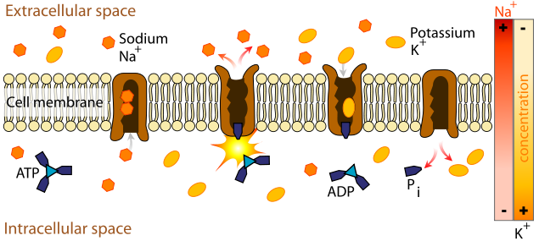
Sodium-potassium pump
https://www.youtube.com/watch?v=_bPFKDdWlCg
Notes:
http://commons.wikimedia.org/wiki/File:Scheme_sodium-potassium_pump-en.svg

Slide 16
Resting membrane potential
Sodium and Potassium are both positive charged.
The Sodium is mostly outside the cell. The cell membrane is only partially permeable to Sodium ions.
The Potassium is mostly inside the cell. The cell membrane is fully permeable to Potassium ions.
The potassium ions diffuse out of the cell along the concentration gradient, making the inside of the cell less positive (more negative) and the outside more positive. The membrane is said to be polarised.
The sodium-potassium pump maintains this concentration gradient.

Slide 17
When a nerve is stimulated
When a stimulus is applied to a nerve fibre.
The permeability of the membrane toward sodium ions increases.
The inward movement cannot be balanced out by the exit of potassium ions
The membrane becomes depolarised (the membrane potential becomes more positive).
The depolarisation effect is an all or none response. The size of the response (depolarisation) is not related to the size of the stimulus.

Slide 18
Action potential
The depolarisation then repolarisation of a cell membrane.
Notes:
http://www.answers.com/topic/action-potential

Slide 19
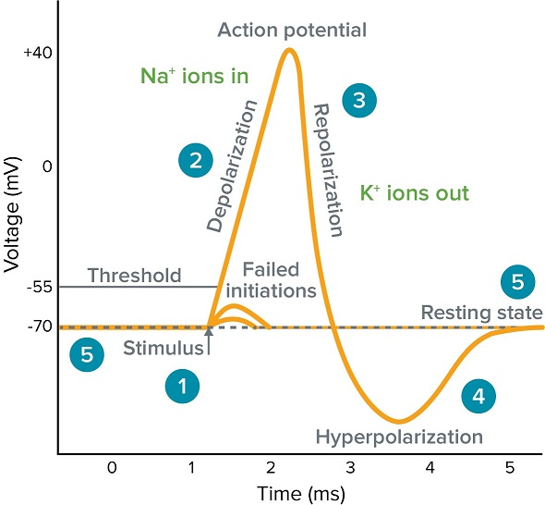
Stimulus starts the rapid change in voltage or action potential. In patch-clamp mode, sufficient current must be administered to the cell in order to raise the voltage above the threshold voltage to start membrane depolarisation.
Depolarisation is caused by a rapid rise in membrane potential opening of sodium channels in the cellular membrane, resulting in a large influx of sodium ions.
Membrane Repolarisation results from rapid sodium channel inactivation as well as a large efflux of potassium ions resulting from activated potassium channels.
Hyperpolarisation is a lowered membrane potential caused by the flowing out of potassium ions and closing of the potassium channels.
Resting state is when membrane potential returns to the resting voltage that occurred before the stimulus occurred.

Slide 20
Action potential
The depolarisation response described on the previous slide – causes the inside of the cell to become positive in comparison to the outside of the cell.
The sodium ion channels in the cell membrane will then close (permeability decreases to normal levels) and the membrane returns to the resting membrane potential.

Slide 21
Action Potential
https://www.youtube.com/watch?v=OZG8M_ldA1M

Slide 22
Transmission of the nerve impulse along unmyelinated fibres
Because the axon is a cell the sodium ions that diffuse into the cell will diffuse within the cell to areas of lower concentration. As a result this will stimulate the area adjacent to it.
The part of the axon that has just been depolarised-repolarised is unable to be stimulated because it is still in the refractory period.
This means the nerve impulse will only move in one direction (not backwards)
Unmyelinated fibres will transmit a message along the membrane at approx. 2m/s

Slide 23
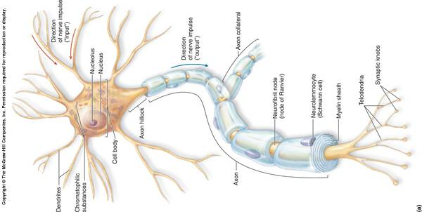
Transmission of the nerve impulse along myelinated fibres

Slide 24
Myelinated fibres - Schwann cells
Nerve cells outside of the CNS have a different type of myelin covering. Specialised cells called Schwann cells wrap around the axon.
There are gaps in the myelin sheath called nodes of Ranvier.
Around the outermost coil of the Schwann cell a structure called the neurilemma forms which helps the repair of injured fibre (fibre usually refers to an axon)

Slide 25
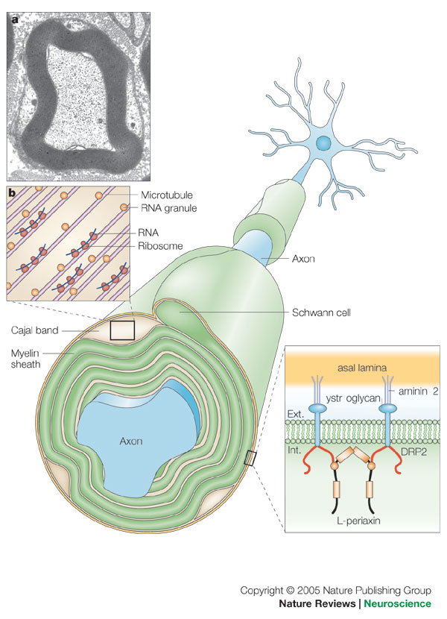
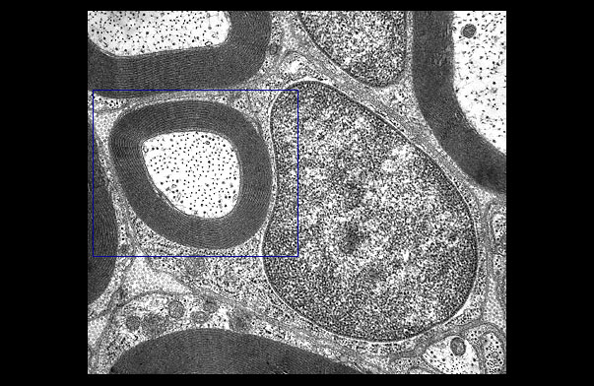

Slide 26
Transmission of the nerve impulse along myelinated fibres
The myelin sheath acts as insulation. Ions cannot flow between the inside and outside of the cell. As a result no action potential can form.
The action potential jumps from one node of Ranvier to the next.
This is jumping process is known as saltatory conduction.
This allows the nerve impulses to move much faster (between 18m/s and up to 140m/s)

Slide 27
Strength of stimulus
If the impulse sent is always the same magnitude how do we tell the difference between stimulus of different intensity?
Strong stimulus causes depolarisation of more nerve fibres
Strong stimulus causes more impulses in a given time compared with a weak stimulus.

Slide 28
Transmission across a synapse.
There is a small gap between the axon of one cell and the cell body of the next.
The nerve impulse stimulate the axon to release neurotransmitters.
The neurotransmitters diffuse across the gap and attach to receptors on the next neuron.
The neurotransmitters cause an action potential to form in the second cell and the nerve impulse continues.

Slide 29
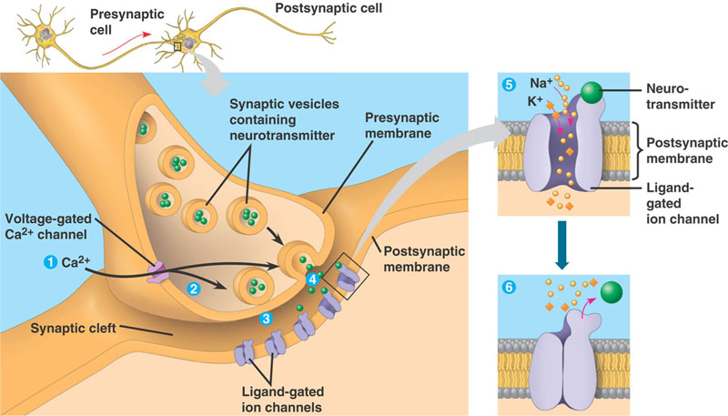
Transmission across a synapse.
There is a small gap between the axon of one cell and the cell body of the next.

Slide 30
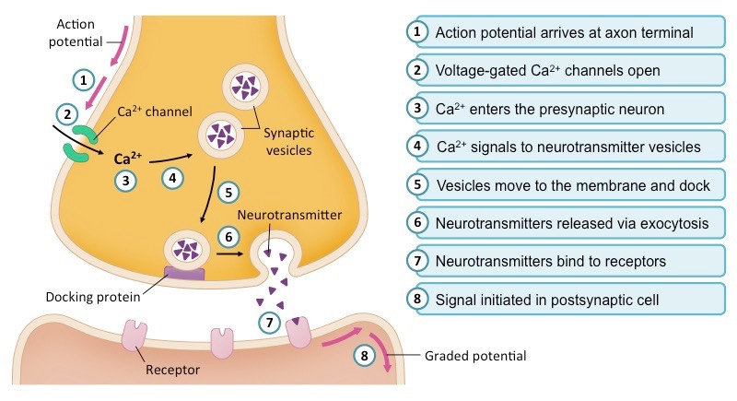
Draw me on blank paper.

Slide 31
Effect of chemicals on transmission
Effect transmission at the synapse or neuromuscular junction (gap between nerve cell and muscle cell)
Stimulants – caffeine, benzedrine
Depress transmission – anaesthetics, hypnotics, venom

Slide 32
Comparing the endocrine system and nervous system
Characteristic | Nervous system | Endocrine system
Nature of message | Electrical impulses and neurotransmitters | Hormones
Transport of message | Along the membrane of neurons | By the bloodstream
Cells affected | Muscle and gland cells; other neurons | All body cells
Type of response | Usually local and specific | May be very general and widespread
Time taken to respond | Rapid—within milliseconds | Slower—from seconds to days
Duration of response | Brief—stops quickly when the stimulus stops | Longer lasting—response may continue long after the stimulus has stopped

Slide 33
Exceptions
Some substances may act as both hormones and neurotransmitters e.g. noradrenaline, ADH, dopamine
Some hormones are secreted by neurons e.g. oxytocin and adrenaline
Some hormones and neurotransmitters have the same effect on the target cell e.g. noradrenaline and glucagon both cause glycogen to be broken down to glucose.

